Slide 1

TPC Hackathon Oct. 9-11 -Data, Evaluation, Model- Opening
Charlie Catlett, Rick Stevens
Franck Cappello, Sandeep Madireddy, Eval
Ian Foster, Robert Underwood, Data
Venkatram Vishwanath, Murali Emani, Model
Argonne National Laboratory
Notes:
Thanks for the introduction
Thanks to the organizers for the invitation to give a keynote
Of course, I would like also to thank all the collaborators and students, postdocs and researchers who collaborated with me.
Don’t count, there are more than 450 ;-)
You know it already; it is extremely hard to succeed alone in research. So, I took the easy way: I collaborated with many talented researchers.
I would like to thank all of them for sharing some of their time and for all the discussions we had.

Slide 2
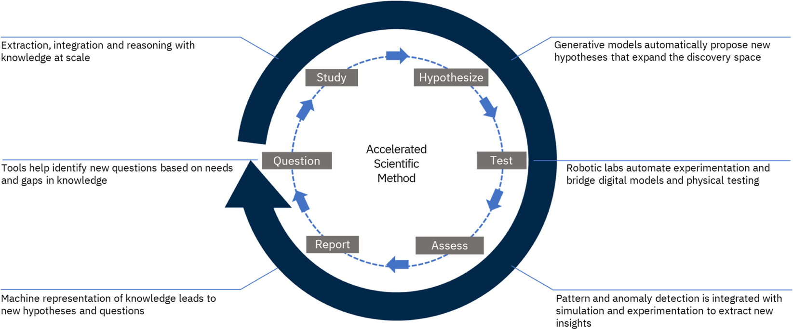
Welcome!
Schedule
Logistics
Evacuation

Slide 3
General Goals
TPC Goal: Identifying and pursuing collaborations that will accelerate progress on responsibly and safely developing large-scale AI models for scientific discovery
Barcelona workshop: Three groups (Data, Evaluation, Models) have begun to form and develop collaborative plans following the Barcelona workshop.
Argonne Hackathon:
Sharing of LLMs for science Data, Evaluation, Model from different TPC participating institutions
Deep dive on important topics for Data, Evaluation and Model
Presentation/discussion/clarification of technical aspects (e.g. deduplication for Data, methodology for Eval)
Identification of potential collaborations between TPC participating institutions
Hackathon is structured to maximize discussion
Every talk is 5 minutes + 10 minutes of questions/discussion
Report progress for Data, Eval, Model Thursday morning and Friday noon

Slide 4

Schedule
Wednesday - October 9, 2024 13:00-14:00 Plenary: Hackathon Goals (Ian Foster, Franck Cappello)
Intro (10 min.), Data (15 min.), Eval (15 min.), Model (15 min.)
14:00-15:30 Session 1
Eval - State of the Eval
Data – state of the projects
15:30-16:00 Break
16:00-17:30 Session 2
Eval MCQs, way forward for a lasting methodology
Data – Workflows for Data Hackathon
Dinner in self-organized small groups
Thursday - October 10, 2024
08:00-08:30 Coffee and Breakfast Snacks
08:30-09:00 Plenary: updates from day 1, all groups (Data, Eval, Model)
09:00-09:30 Plenary Salman Habib (15 + 15)
09:30-10:45 Session 3
Eval+data - Data Sources/Eval – Narratives
10:45-11:00 Break
11:00-12:30 Session 4
Eval+data -Multi-modal, RAG, Dedup
12:30-14:00 Lunch (provided)
14:00-15:30 Session 5
Eval - Safety - Redteaming
Data – Workflows for Data Hackathon, continued
Model Architecture and Performance
15:30-16:00 Break
16:00-17:30 Session 6 (Eval: AI Safety and Reliability)
Eval - Proxy Benchmark, Metrics, UQ
Data Datamix and Experimentation
Model Architecture and Performance
Dinner at Argonne Guest House restaurant
https://tinyurl.com/y65yafvj

Slide 5
Schedule
https://tinyurl.com/y65yafvj
Friday - October 11, 2024
09:00-09:30 Coffee and Breakfast Snacks
09:30-10:00 Session 7
Eval – Roadmapping skills and safety
Data – Workflows for Data Hackathon, continued; demo progress
Model Architecture and Performance
10:00-10:30
Generating the slides for the plenary at 11:00
10:30-11:00 Break
11:00-12:30 Plenary: Hackathon outcomes
Readout - 30 min per group
12:30-14:00 Lunch and Adjourn

Slide 6

Hackathon slides / session notes
https://tinyurl.com/3kv37cf9

Slide 7
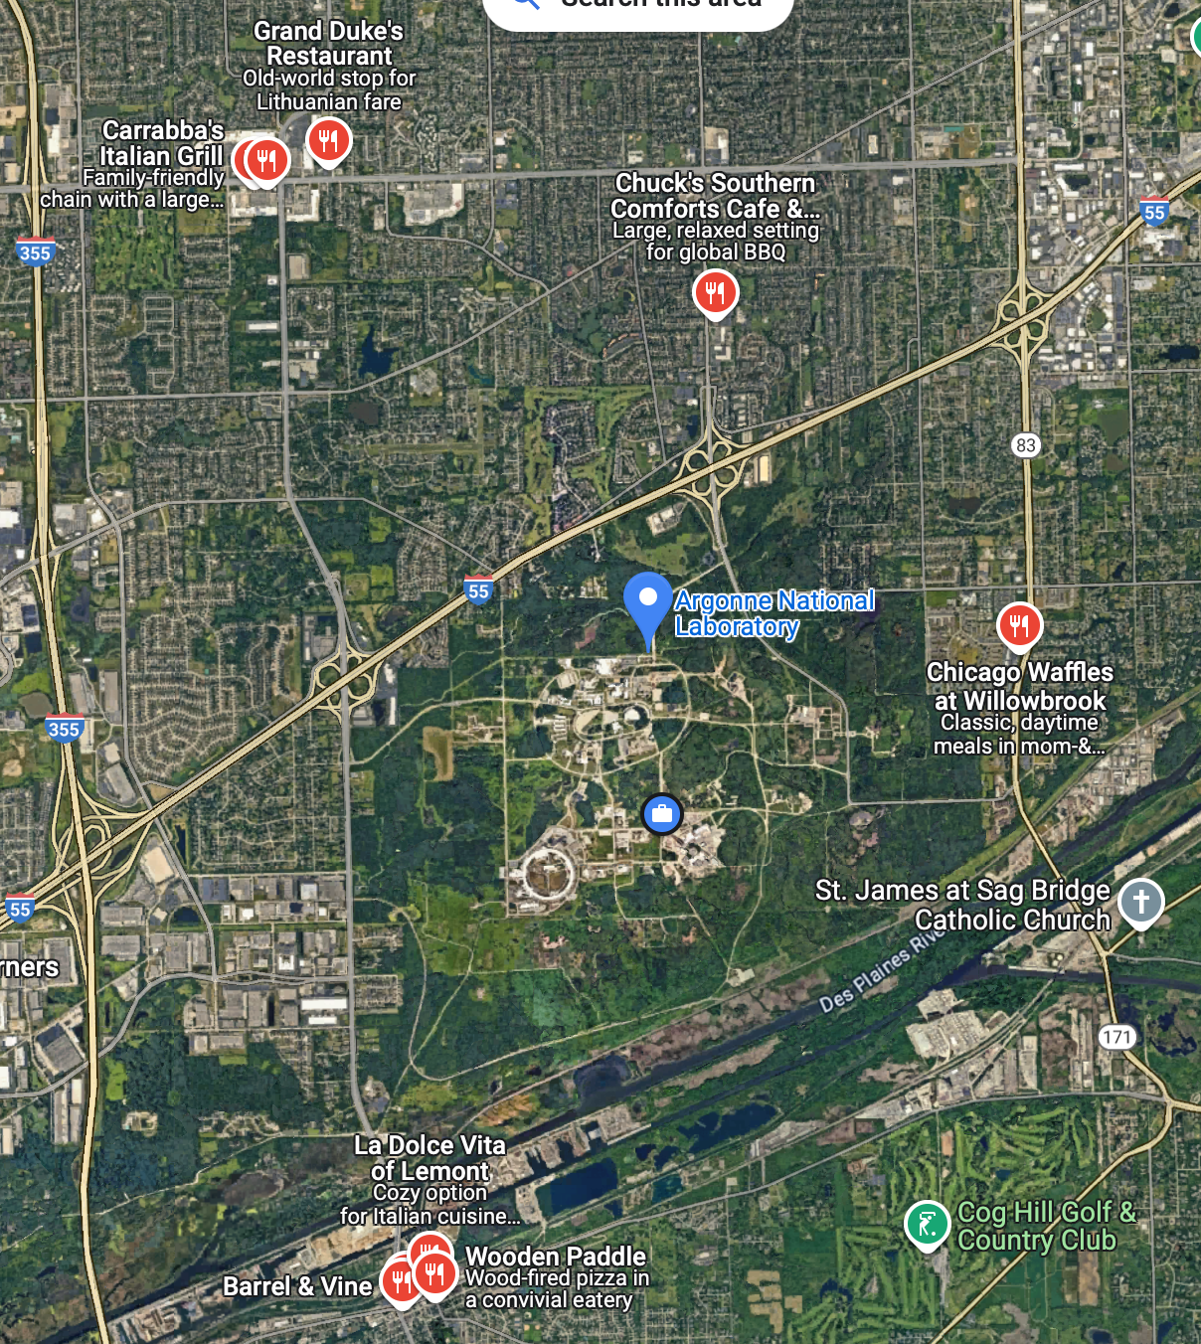
Logistic
Lunches (provided Thursday and Friday)
Dinners (self organized tonight, guest house tomorrow)

Slide 8
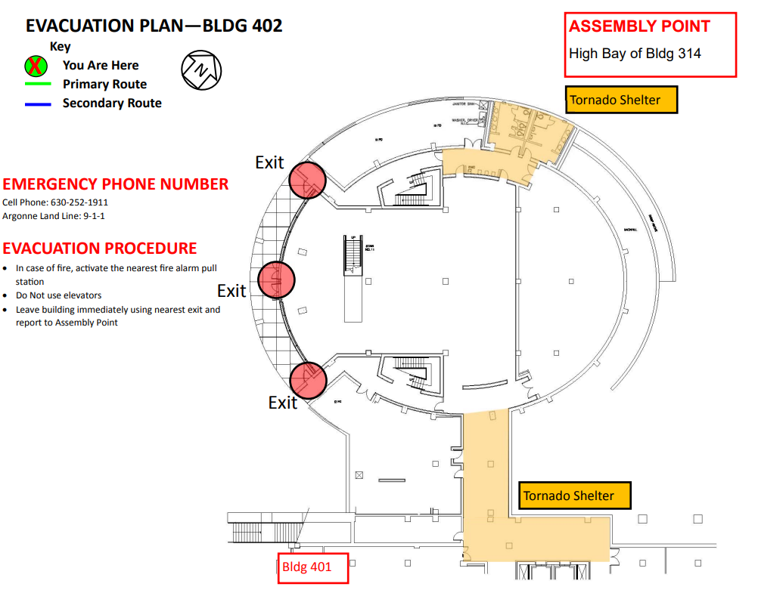
Evacuation Plan

Slide 9
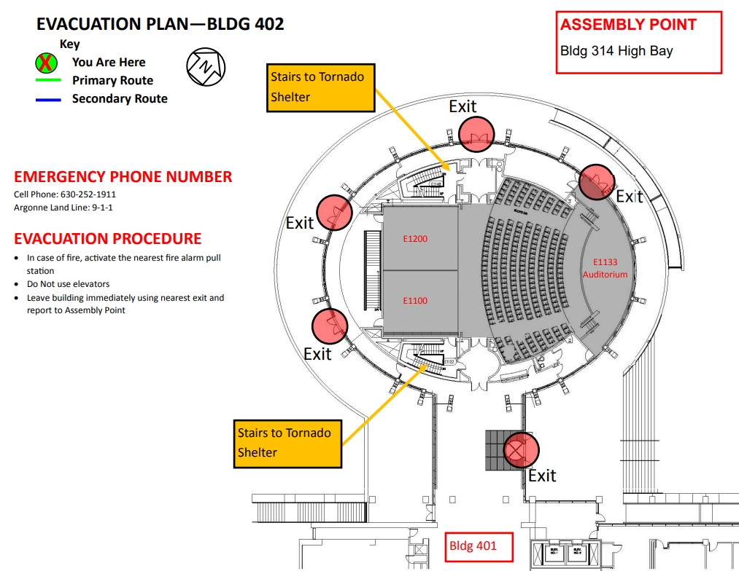
Evacuation Plan

Slide 10
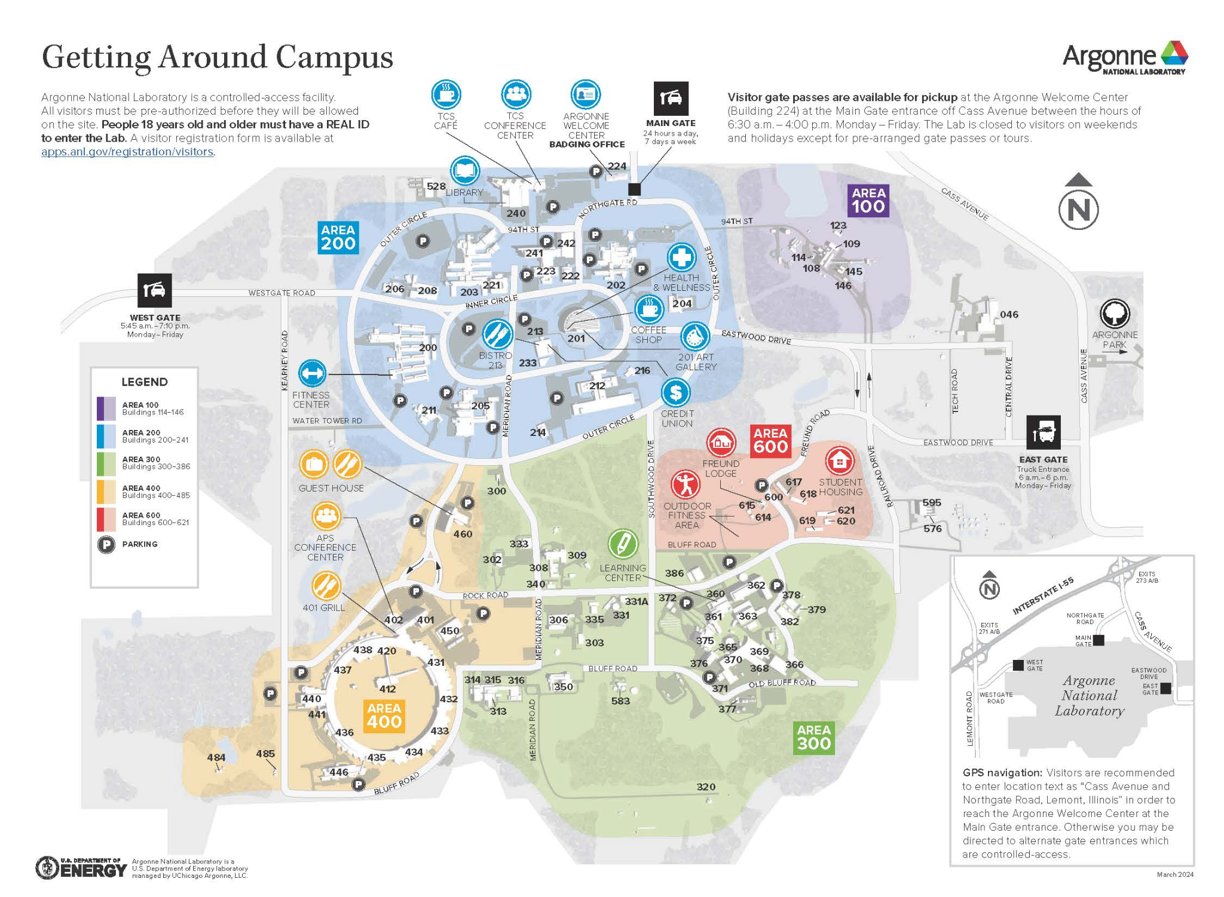
Evacuation Plan

Slide 11
Goals and Topics
Data
Eval
Model
Notes:
Of course, I would like also to thank all the collaborators and students, postdocs and researchers who collaborated with me.
Don’t count, there are more than 450 ;-)
You know it already; it is extremely hard to succeed alone in research. So, I took the easy way: I collaborated with many talented researchers.
I would like to thank all of them for sharing some of their time and for all the discussions we had.

Slide 12
Data topics (Ian, Robert)
In the era of exponential data growth, this session addresses critical challenges and innovative strategies in harnessing vast datasets needed for training large language models (LLMs) in domains such as chemistry/materials, biology, climate science, and high-energy physics. Challenges include the complexities of developing a data-focused infrastructure, including streamlined data curation pipelines, the refinement of data curation practices, and the application of pre-training methodologies. It is also critically important to explore how the incorporation of domain-specific knowledge into these processes can significantly enhance the performance and applicability of LLMs in scientific research, emphasizing the critical role of targeted data selection and preparation in advancing AI capabilities.
Objectives for this Hackathon
Develop and begin to implement a strategy for making datasets and data preparation methods available for incorporation in project-specific corpora.
Identify data sets that can be shared, including multiple languages.
Identify multi-model datasets and corresponding evaluations in use by participant institutions.

Slide 13
Data Track Schedule Overview
Wednesday (PM)
Session 1:
State of the Projects
Break
Session 2:
Data Ingest
Scaling and Dedup
Curation
Databases
Thursday (AM+PM)
Session 3-4: Data and Eval for
Multimodal
Lunch
Session 5:
Hackathon
Break
Session 6:
Scaling Ablations
Friday (AM)
Session 7:
Demos and Planning
Lunch
Adjourn

Slide 14
Eval topics (Franck, Sandeep)
Robust, rigorous, comprehensive evaluation is critical to establish scientific user trust in LLMs to assist research
Only very few available benchmarks specifically are related to science.
Establishing LLM benchmarks for science requires the identification of how scientists will actually use LLMs
We will discuss the methods, techniques, and challenges of LLMs skills, trustworthiness, and safety evaluation for science applications. We will also discuss the related efforts in the multilingual (Spanish, European, English).
Objectives for this Hackathon
Review the current method to identify LLMs use cases in the scientific context.
Identifying a multi-faceted/multi level evaluation methodology that can be shared from various domains.
Discuss existing benchmarks for science.
Review approaches to detect hallucination including subtle ones.
Present Argonne’s Multiple Choice Question (MCQ) initiative and the challenge of generating/validating MCQs.
Identifying new perspectives needed for red-teaming AI models, to mitigate potential risks and align with industry-standard safety benchmarks to develop safe and secure AI for science.
Identify good attack prompts that work well for science redteaming and other optimization, embedding and diversity techniques to generate successful prompts
Creation of proxy benchmarks for sensitive science areas
Create a charter and review potential members for an international structure similar to what has been done for large-scale science projects, with co-chairs and representation from multiple scientific domains.

Slide 15
Eval Track Schedule Overview
Wednesday (PM)
Session 1:
State of the Eval
Break
Session 2:
Multi-Choice Questions
Add “thinking time” as a new metric
Definition of difficulty and way forward
Thursday (AM+PM)
Session 3-4: Data and Eval for
Multimodal
Lunch
Session 5:
AI Risk, Trustworthiness and Reliability (Safety Evaluation and Red-teaming)
Break
Session 6:
Creation of proxy safety benchmarks
Reliability Metrics, Uncertainty Quantification and Hallucination detection
multimodal models
Friday (AM)
Session 7:
Gap identification, proposed direction, collaborations
Roadmapping Skills
Roadmapping Safety
Lunch
Adjourn

Slide 16
Model topics (Murali, Venkat)
Architectures for LLMs are continuously evolving with variants of transformers, their mixture-of-experts-based extensions, and state-space models are developed at a rapid pace. Frameworks such as Megatron-LM and DeepSpeed, and their various forks each cover a different subset of architectures, distributed parallelism, and compute/memory/IO optimizations. Determining the optimal architecture for training a trillion parameter model on scientific data, and the best framework to accomplish this on today’s Exascale platforms is critical for the creation of a new class of AI models for a broad range of scientific applications.
Objectives for this Hackathon
Identify benchmarks to use: Llama-7B and micro-kernels that reflect a transformer-block/ attention mechanism and collective communication library (CCL) core operations.
Profile these on Sophia with varying distributed training techniques and learn best practices.
Scripts to collect metrics that capture compute, memory, BW utilization, model flop utilization and compute-to-communication ratio besides FLOPS
Run these scripts at small scale and at large scale (number of nodes), extract metrics and identify key performance bottlenecks
Understand impact of various CCL environment variables on model performance

Slide 17
Model Track Schedule Overview
Wednesday (PM)
Thursday (AM+PM)
Lunch
Session 5:
Identify performance benchmarks
Develop steps to profile
Select frameworks to profile: system- and framework-specific tools
Break
Session 6:
Run scripts to collect metrics at small scale and large scale
Understand impact of various CCL environment variables on performance
Dinner at Guest House
Friday (AM)
Session 7:
Gap identification, proposed direction in best practices for optimizing model performance at scale
Chalk out a roadmap for collaborations
Lunch
Adjourn

Slide 18
Session 1: 14:00
Eval room: E1100
Data room: E1200
Break at 15:30
Session 2: 16:00
Eval room: E1100
Data room: E1200
End at 17:30

